Slide 1
optional project

Slide 2
A mini project
Guided programming. Designed to help you make a project.
Last indefinitely many recitations.
This will not be graded.
You are encouraged to extend this project beyond our spec.
You are encouraged to try other ways to do this.
Sharing code with others is allowed.
We don’t want to unreasonably take too much of your time

Slide 3
Overview
A line based text editor
Basic line manipulation
Search/replace
Does not display whole file on screen
Not POSIX compatible
We only have a reduced command set to fit in recitation time.
Feel free to extend it.

Slide 4
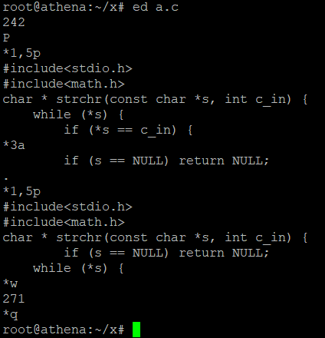
Unix ed
Commands: (start_line,end_line)action
Operate on selected lines
Action P turns on prompt
Action a append several line to selected
Action p print out selected lines
Action w write the buffer to disk
Action q quit the editor

Slide 5
Our spec
Line selection:
Absolute selection: (3,5)
Relative selection: (+3,+5)
Commands to implement
a <arg>: append one line <arg>
w: write back
p: print selected lines
pp: print every line
s <arg>: search for <arg> (plain text) in selection
r <arg1> <arg2>: replace every <arg1> with <arg2> in selection

Slide 6
Design considerations
One large main()?
Not going to work
We will condemn you for such behavior
Your code will be in “Code Smell” section next recitation
One large .c file?
Split it into pieces?
Use headers?
Decide these as you go, not from the start

Slide 7
Design considerations
Single huge buffer vs multiple smaller line buffers?
Ease of programming?
Are you skilled enough?
Do you have like 40 hours to spend on this thing?
Efficiency?
Will this be invoked a billion time?
Will this take a huge amount of time to complete?

Slide 8
Design considerations
How to organize line buffers?
Fixed length array?
Wasteful on small file
Crash on large file
Dynamic array
Line insertion?
Line removal?
The only choice so far……

Slide 9
Today’s menu
Implement search and replace
Search for first occurrence in a few selected lines
Replace all occurrence in a few selected lines
Write a simple main to test it out

Slide 10
Design considerations
How should I search/replace?
Write by hand?
Show of skill
Again, 40 hours for this?
string.h?
Which to use?
Side effects?
Barely any

Slide 11
Design considerations
How should other part of the program use this search/replace?
What this part need?
Lines to search in
String to search for
Replacement (only for replace)
What other part need?
The line number
The resulting lines
Function prototype?
Think for a while

Slide 12
Search/replace prototype
Puzzled by the pointers?
The more you practice, the more likely you understand
Ask your questions
int line_search(const char ** haystack, int len, const char *needle); char **line_replace(char ** haystack, int len, const char *needle,
const char* replacement);

Slide 13
Search/replace prototype
Notice the similarity
Both need haystack & needle
Can we reuse some code?
Let line_replace call line_search instead of reinvent searching.
int line_search(const char ** haystack, int len, const char *needle); char **line_replace(char ** haystack, int len, const char *needle,
const char* replacement);

Slide 14
Design considerations
What should I test?
Randomly generated input?
Could be.
You (should) don’t know how to do that though.
Not exhaustive.
Crafted input trying to break everything, i.e. hackers?
We won’t consider it.
Yet, of-by-one errors will still go to “code smell” section

Slide 15
Interesting Questions
VLA: Variable length arrary
int vla[argc];
Length not determined at compile time
Pros
Convenient
Fast
Clear
Cons
Not portable, e.g. MSVC
Stack overflow
Use at your own peril

